Slide 1
Pillars of Safety
By Jiles Smith II - JS Risk Consulting

Slide 2
Pillars of Safety
My Background
How do you see the issue of safety
What some team members think about safety
Why change is so important
Why Pillars of Safety
Four keys to addressing change
Why Change is so hard
What are the Pillars of safety

Slide 3
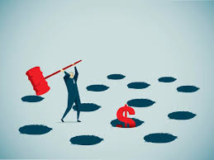
How leaders sometimes see safety

Slide 4
Pillars of Safety
Accountability
Authority
Empowerment
Responsibility

Slide 5
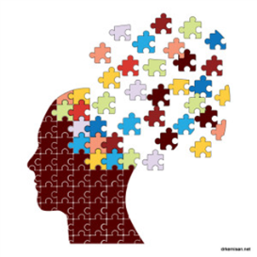
Why change is so important

Slide 6
How team members learn

Slide 7
What some team members think about safety
The company/supervisor is responsible for my health and safety.
It is the companies responsibility tell us what to do. We can’t questions the leadership.
I can’t do anything about safety.
They don’t really care about us and our safety.

Slide 8
Four keys to addressing change
Individual Accountability?
Give Authority
Support Empowerment
Drive Responsibility

Slide 9
Pillars of Safety
Go home the same way you came in.
You’re responsible for your own safety and the safety of those around you.
You’re empowered to stop the line.
4. If you see something say something

Slide 10
WHY CHANGE SO HARD
1. I have done this task before
and not gotten hurt.
2. I can not make a mistake
or I face consequences.
3. I will follow the rules
because I need a paycheck
4. I have 20 years of experience.
No one can challenge me.
1. Always the way
I do my job. Autopilot.
2. Methods Tried and Tested,
with no need to change.
3. Just needed to get the job
done. Will only take a minute.
Perceptions
Habits
Conscious choices
Subconscious choices
Internal
External
Influences
Influences
Habits
Limited Choices
Barriers
Obstacles
1.Change perception with information.
2. Change habits with reminders. Drip Feed.
3. Set a good example.
Adapted From ProActs Safety

Slide 11
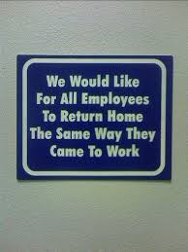
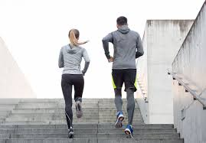
Go home the same way you came in
According to NSC Injury Facts, there were over three times (3.5 to 1) as many off-the-job injuries that required medical attention as on-the-job injuries. That means team members were still missing time from work due to injuries which inevitably has an impact on the company’s bottom line.
This means not only are most injuries are preventable but more time is missed for non-industrial conditions than for Industrial ones.

Slide 12
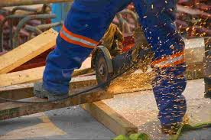
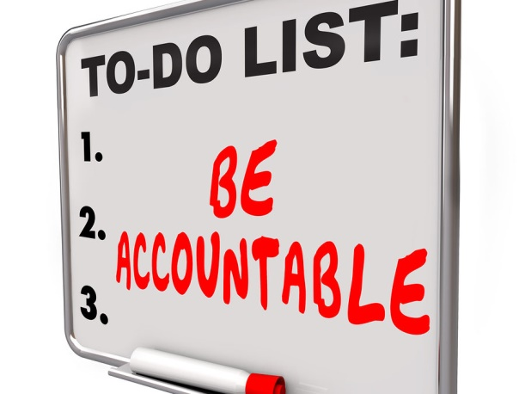
You’re responsible for your own safety and the safety of those around you.
“If we had better gloves, we’d wear them,” you hear from the safety whiners on job sites. “If we had more comfortable eye protection, we wouldn’t keep taking them off.” “It’s too hot to wear vests.” “Our hearing protection is too tight.”
These are all complaints that anyone who has spent any time in the field has heard - maybe even said. And every one of them points the finger at the company to fix it. The whole personal accountability piece goes missing when it’s whine-time.

Slide 13
You’re empowered to stop the line.
You do not have to do any job you believe is dangerous.
Have you ever heard “I had to. I thought it was dangerous but it had to be done, so I did it”.

Slide 14
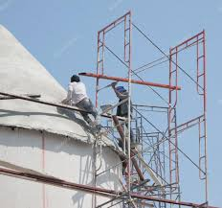
If you see something say something
If you see an act or condition that could cause hazard or
harm, it is your responsibility to not only correct or report it.
If you report it, it is your responsibility to check to make
sure it is done.

Slide 15
Intervention - Culture & Behavioral
Willingness to Intervene sets right Culture – Culture Influences Behavior
Support the Positive Message, and do not over-react to the negative.
Understand that the receiver has a stake in the intervention too.
Interventions are part of the right culture. People have to be willing to speak up
Culture Change “Trickle down””
Right solutions
Right Problems
Behavioral Change Critical Components – Behavioral Change is a Choice
Strong Peer message. Relationships need to be built, & interventions welcomed.
Intervention can become part of how we do our job, and can become a habit.
Keep drip feeding the intervention message, and reward good behaviors
Right People
Right measures
Behavior Change “Bubble Up””
Modes of Cultural Change

Slide 16
Pillars of Safety
Go home the same way you came in.
You’re responsible for your own safety and the safety of those around you.
You’re empowered to stop the line.
4. If you see something say something

